Slide 1



















Tahaluf Copyright 2022- All Right Reserved
Harmony IT Solution
learning Hub
Web Application Programming Interface (API)
Tahaluf Training Center 2022

Slide 2



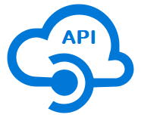





Tahaluf Copyright 2022- All Right Reserved
Harmony IT Solution
1
Overview of Onion Architecture
2
Layers of Onion Architecture
3
Benefits of Onion Architecture
4
Overview Of DB Context
4
5
Create DB Context
6
Create Domain Layer (Database First)
8
8
9

Slide 3










Tahaluf Copyright 2022- All Right Reserved
Harmony IT Solution
Overview of Onion Architecture

Slide 4

Tahaluf Copyright 2022- All Right Reserved
Harmony IT Solution
The majority of traditional architectures have inherent flaws with tight coupling and separation of concerns.
Jeffrey Palermo proposed the Onion Architecture to give a better approach to build applications in terms of testability, maintainability, and reliability.

Slide 5
Tahaluf Copyright 2022- All Right Reserved
Harmony IT Solution
Onion Architecture was created to solve the issues that 3-tier architectures face, as well as to give a solution to common challenges.
Interfaces are used by onion architecture layers to communicate with one another.

Slide 6
Tahaluf Copyright 2022- All Right Reserved
Harmony IT Solution
Layers of Onion Architecture

Slide 7
Tahaluf Copyright 2022- All Right Reserved
Harmony IT Solution
UI
Service
Repository
Domain Entities

Slide 8
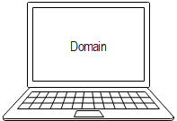
Tahaluf Copyright 2022- All Right Reserved
Harmony IT Solution
Domain Layer
The domain layer, which represents the business and behavior objects, is located in the heart of the Onion Architecture. The goal is to have this core contain all of your domain objects. It's where you'll find all of your application's domain objects.

Slide 9
Tahaluf Copyright 2022- All Right Reserved
Harmony IT Solution
Domain Layer
You could have domain interfaces in addition to domain objects. There are no dependencies between these domain objects. Without any heavy code or dependencies, domain objects are likewise flat, as they should be.

Slide 10
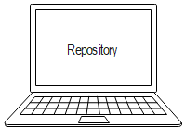
Tahaluf Copyright 2022- All Right Reserved
Harmony IT Solution
Repository Layer
This layer creates an abstraction between an application's domain entities and its business logic. We normally include Interfaces at this layer that provide object saving and retrieving functionality, usually through the use of a database. The data access pattern, which is a more loosely coupled approach to data access, is part of this layer.

Slide 11
Tahaluf Copyright 2022- All Right Reserved
Harmony IT Solution
Repository Layer
We also build a generic repository and implement queries to extract data from the source, map data from the data source to a business entity, and persist business entity updates to the data source.

Slide 12
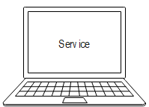
Tahaluf Copyright 2022- All Right Reserved
Harmony IT Solution
Service Layer
Add, Save, Edit, and Delete some common activities available through the Service layer. This layer also acts as a link between the UI and repository layers. The entity's business logic might potentially be stored in the Service layer. Service interfaces are maintained separate from their implementation on this layer, ensuring loose coupling and separation of concerns.

Slide 13
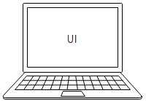
Tahaluf Copyright 2022- All Right Reserved
Harmony IT Solution
UI
It's the top layer, and it's where things like UI and tests are kept. It represents the Web API for the Web application. The dependency injection principle is used in this layer, allowing the application to design a loosely linked structure and communicate with the internal layer via interfaces.

Slide 14
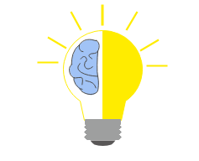
Tahaluf Copyright 2022- All Right Reserved
Harmony IT Solution
Benefits of Onion Architecture
Interfaces link the layers of the onion architecture.
A domain model forms the base for application architecture.
All external dependencies, like database access and service calls, are represented in external layers.
There are no external layers that are dependent on the Internal layer.

Slide 15
Tahaluf Copyright 2022- All Right Reserved
Harmony IT Solution
Benefits of Onion Architecture
The couplings are at the center.
Architecture that is flexible, sustainable, and portable.
Because the application core is independent of everything, it can be easily tested.

Slide 16
Tahaluf Copyright 2022- All Right Reserved
Harmony IT Solution
Overview of DB Context

Slide 17

Tahaluf Copyright 2022- All Right Reserved
Harmony IT Solution
A DbContext instance is a session with the database used to retrieve and store instances of your entities.

Slide 18
Tahaluf Copyright 2022- All Right Reserved
Harmony IT Solution
Create DB Context

Slide 19
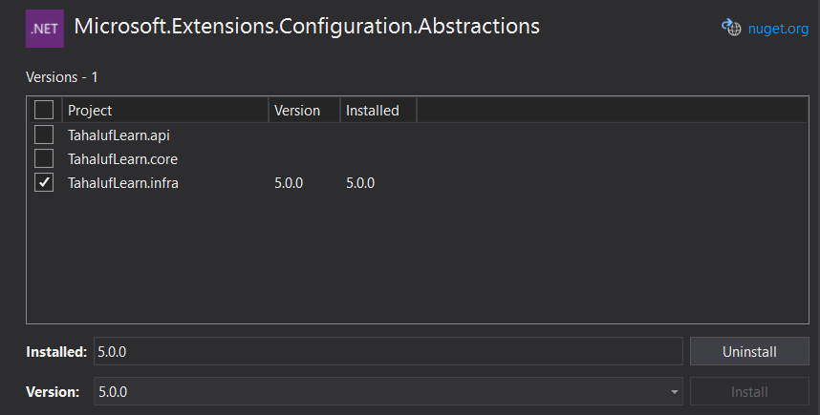
Tahaluf Copyright 2022- All Right Reserved
Harmony IT Solution
Install Packages
Tools => NuGet Package Manager => Manage NuGet Packages for Solution => Install Microsoft.Extensions.Configuration.Abstractions

Slide 20
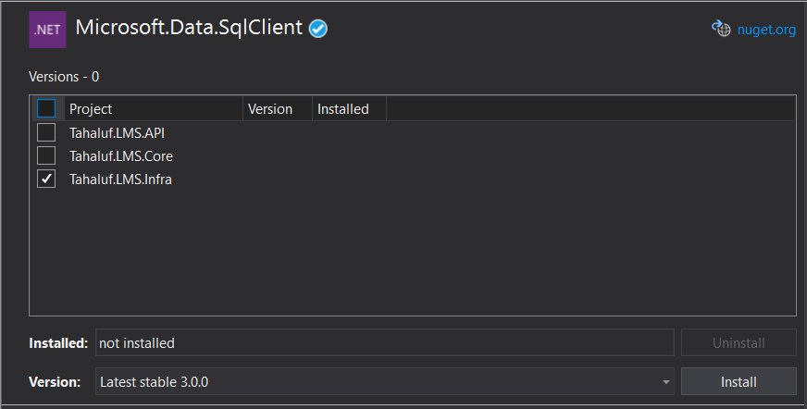
Tahaluf Copyright 2022- All Right Reserved
Harmony IT Solution
Install Packages
Tools => NuGet Package Manager => Manage NuGet Packages for Solution => Install Microsoft.Data.SqlClient.

Slide 21
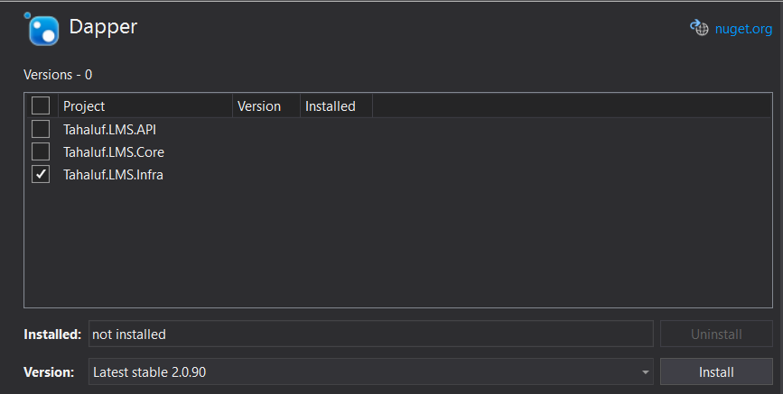
Tahaluf Copyright 2022- All Right Reserved
Harmony IT Solution
Install Packages
Tools => NuGet Package Manager => Manage NuGet Packages for Solution => Install Dapper.

Slide 22
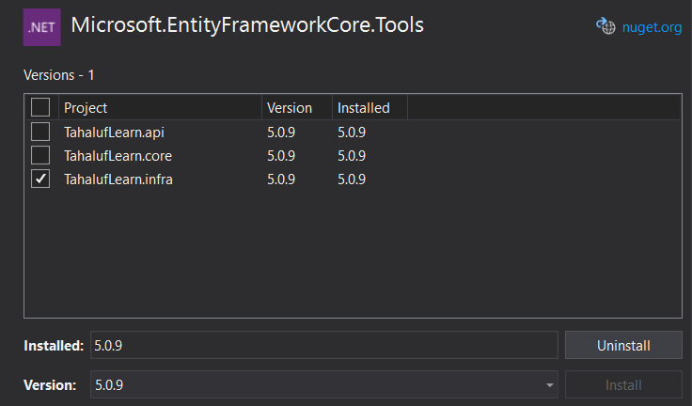
Tahaluf Copyright 2022- All Right Reserved
Harmony IT Solution
Install Packages
Tools => NuGet Package Manager => Manage NuGet Packages for Solution => Microsoft.EntityFrameworkCore.Tools

Slide 23
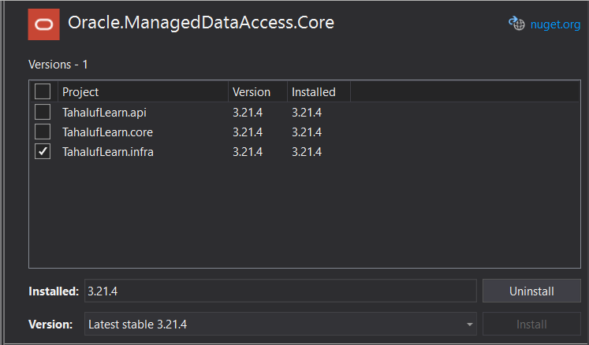
Tahaluf Copyright 2022- All Right Reserved
Harmony IT Solution
Install Packages
Tools => NuGet Package Manager => Manage NuGet Packages for Solution => Oracle.ManagedDataAccess.Core

Slide 24
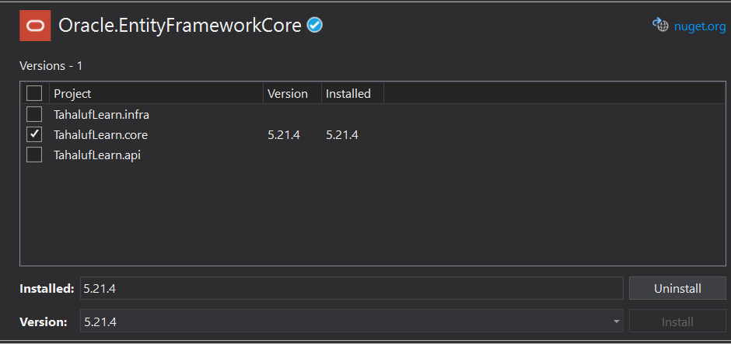
Tahaluf Copyright 2022- All Right Reserved
Harmony IT Solution
Install Packages
Tools => NuGet Package Manager => Manage NuGet Packages for Solution => Oracle. EntityFrameworkCore

Slide 25
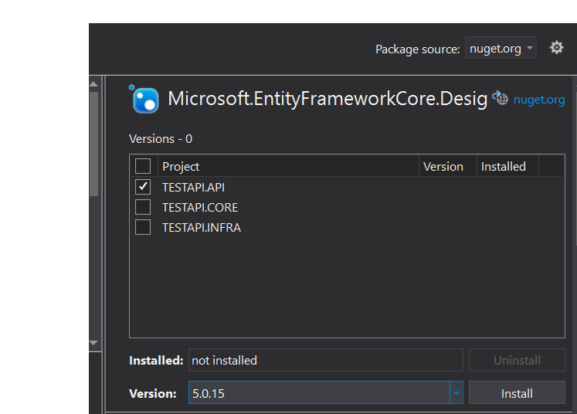
Tahaluf Copyright 2022- All Right Reserved
Harmony IT Solution
Install Packages
Tools => NuGet Package Manager => Manage NuGet Packages for Solution => Microsoft.EntityFrameworkCore.Design

Slide 26
Tahaluf Copyright 2022- All Right Reserved
Harmony IT Solution
Database Connection
Write the following Connection String in app Setting.json:
"ConnectionStrings": {
"DBConnectionString": "Data Source=(DESCRIPTION =(ADDRESS = (PROTOCOL = TCP)(HOST = 94.56.229.181)(PORT = 3488))(CONNECT_DATA =(SERVER = DEDICATED)(SERVICE_NAME = traindb))); User Id=JOR17_User92;PASSWORD=Test321;Persist Security Info=True;"
},

Slide 27
Tahaluf Copyright 2022- All Right Reserved
Harmony IT Solution
Create Common Folder
Right Click on TahalufLearn.Infra => Add => New Folder => Common.
Right Click on TahalufLearn.core => Add => New Folder => Common.

Slide 28
Tahaluf Copyright 2022- All Right Reserved
Harmony IT Solution
Create DbContext Class and Interface
Right Click on Common in TahalufLearn.Core => Add => Class => Choose Interface => IDbContext.
Right Click on Common in TahalufLearn.Infra => Add => Class => DbContext.
Note: Set Class and Interface public.

Slide 29
Tahaluf Copyright 2022- All Right Reserved
Harmony IT Solution
IDbContext Code:
public interface IDbContext
{
public interface IDbContext
{
DbConnection Connection { get; }
}
}

Slide 30
Tahaluf Copyright 2022- All Right Reserved
Harmony IT Solution
DbContext Code:
public class DbContext: IDbContext
{
private DbConnection _connection;
private readonly IConfiguration _configuration;
public DbContext(IConfiguration configuration)
{
_configuration = configuration;
}

Slide 31
Tahaluf Copyright 2022- All Right Reserved
Harmony IT Solution
DbContext Code:
public DbConnection Connection
{
get
{
if (_connection == null)
{
_connection = new OracleConnection
(_configuration["ConnectionStrings:
DBConnectionString"]);
_connection.Open();
}

Slide 32
Tahaluf Copyright 2022- All Right Reserved
Harmony IT Solution
DbContext Code:
else if (_connection.State != ConnectionState.Open)
{
_connection.Open();
}
return _connection;
}

Slide 33
Tahaluf Copyright 2022- All Right Reserved
Harmony IT Solution
Add Services in Startup
Write the following code in Configure services:
services.AddScoped<IDbContext, DbContext>();

Slide 34
Tahaluf Copyright 2022- All Right Reserved
Harmony IT Solution
Create Domain Layer
(Database First)

Slide 35
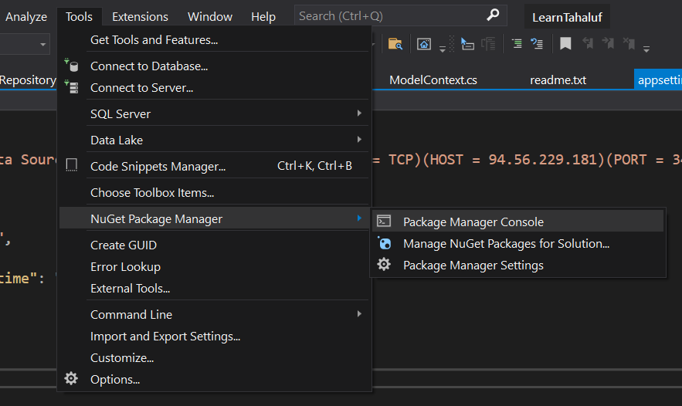
Tahaluf Copyright 2022- All Right Reserved
Harmony IT Solution
Tools => NuGet Package Manager => Package Manager Console.

Slide 36
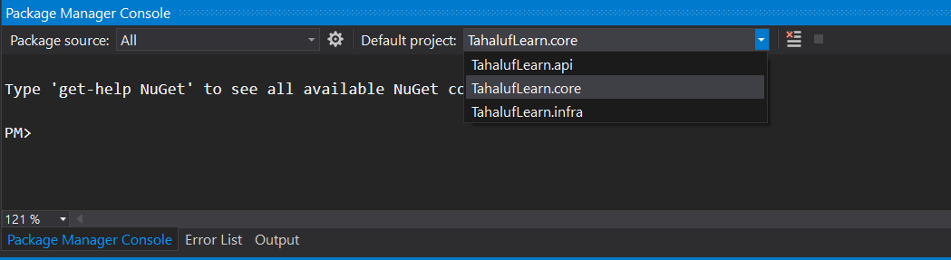
Tahaluf Copyright 2022- All Right Reserved
Harmony IT Solution
Package Manager Console => Default Project => TahalufLearn.Core

Slide 37
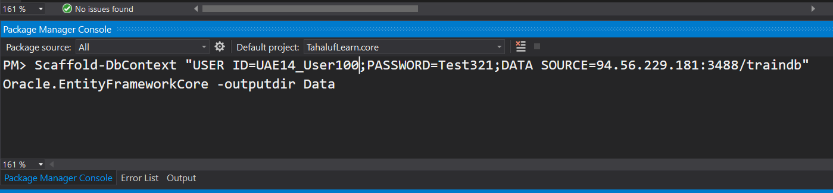
Tahaluf Copyright 2022- All Right Reserved
Harmony IT Solution
Scaffold-DbContext "User Id=JOR17_User92;PASSWORD=Test321;DATA SOURCE=94.56.229.181:3488/traindb" Oracle.EntityFrameworkCore -outputdir Data

Slide 38
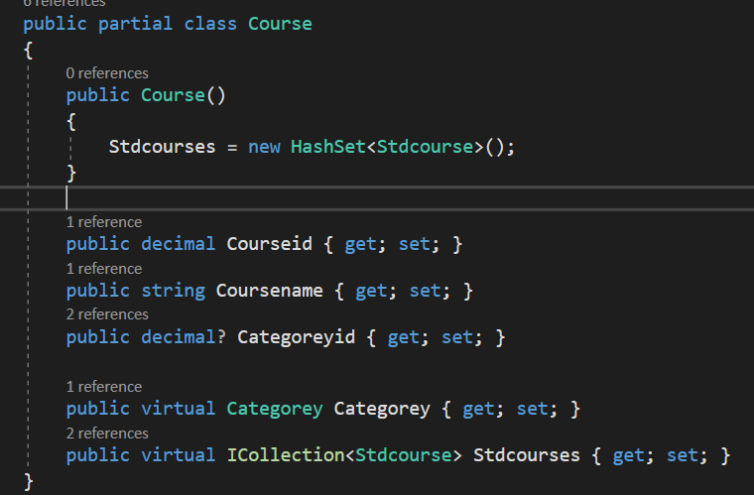
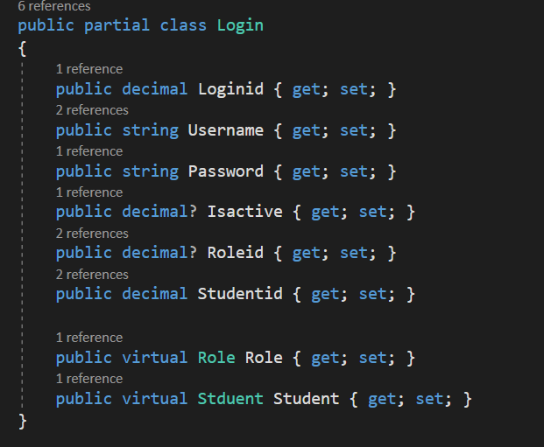
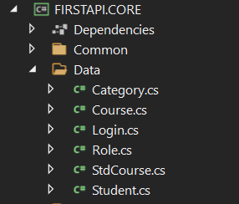
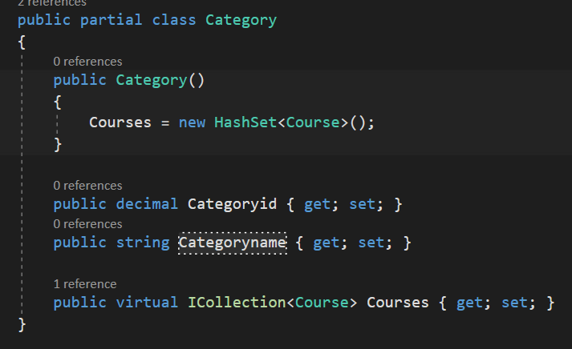
Tahaluf Copyright 2022- All Right Reserved
Harmony IT Solution

Slide 39
Tahaluf Copyright 2022- All Right Reserved
Harmony IT Solution
[1]. https://www.codeguru.com/csharp/understanding-onion-architecture/#:~:text=Onion%20Architecture%20is%20based%20on,on%20the%20actual%20domain%20models
[2]. https://docs.microsoft.com/en-us/dotnet/api/microsoft.entityframeworkcore.dbcontext?view=efcore-5.0

